Slide 1

Survey Results 1
Hannah DeBruin
Weekly Meeting: Transit Data Subgroup
02/28/23

Slide 2
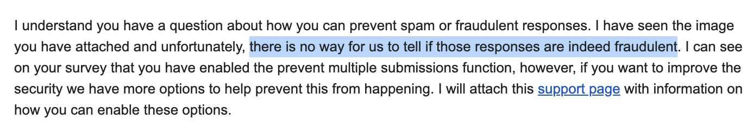
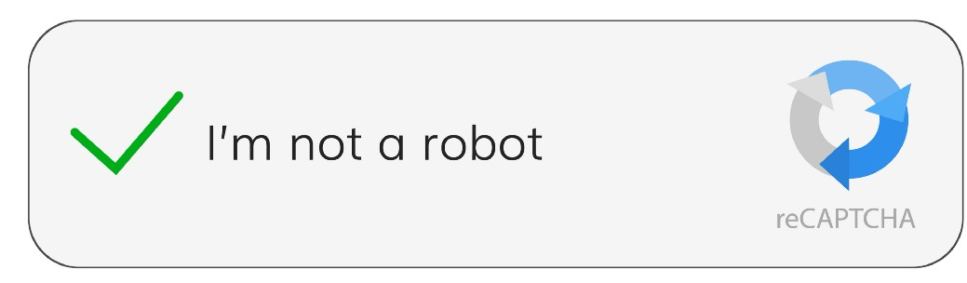
Response Validation
From Qualtrics:
From Fraud Detection Support Page:
“Preventing multiple submissions” will restrict # from the same IP Address and browser (we had this enabled)
“Bot detection” allows you to track which responses are likely bots (this wasn’t turned on)
”RelevantID” compares responses and calculates probability response is a duplicate, fraudulent, or a bot (this wasn’t turned on)
Survey validation through questions – asking similar questions at beginning and midpoint to validate consistency of responses (we didn’t incorporate this in the survey)
Weekly Meeting (02/28/2023)
Hannah DeBruin

Slide 3
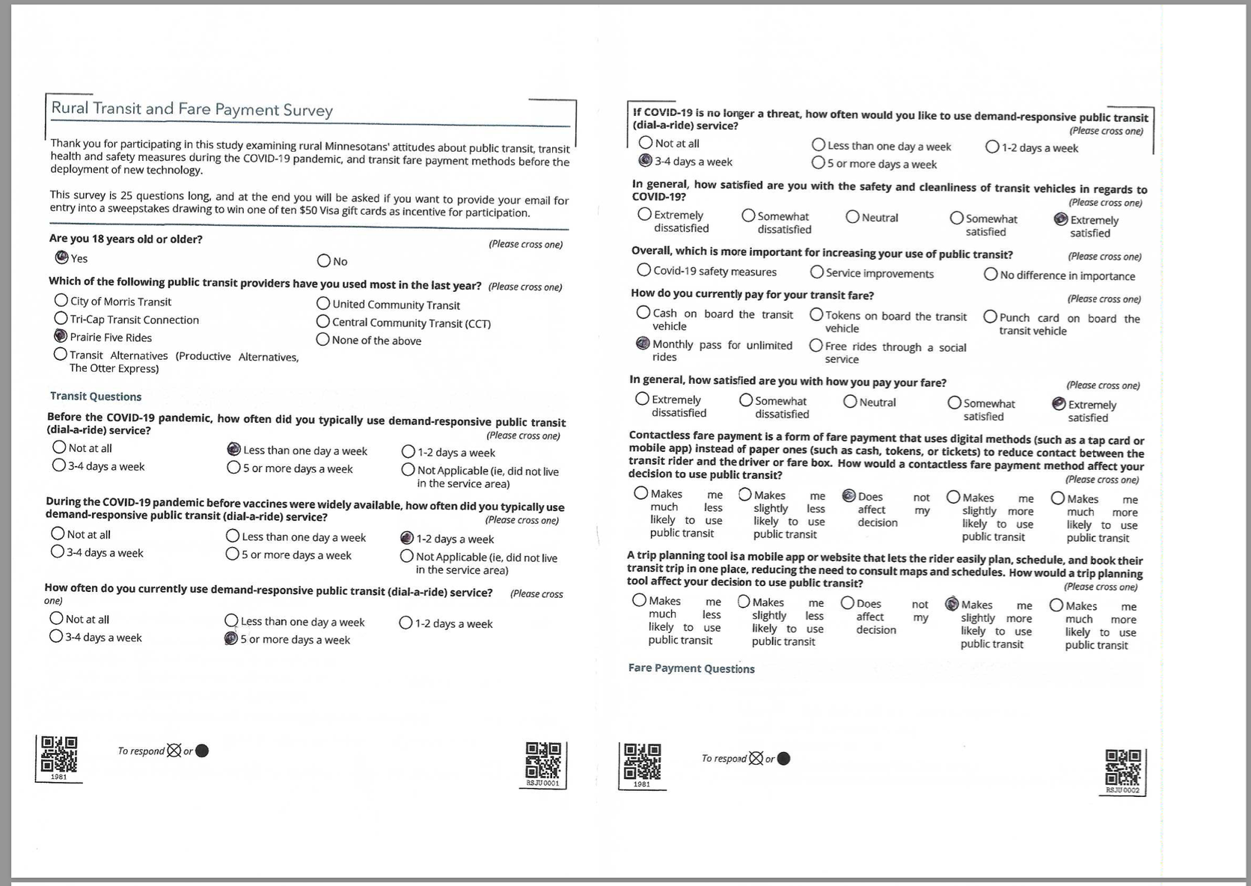
Update on Paper Forms
44 total forms received
require some manipulation for papersurvey.io to receive them
deskew, re-crop for uneven margins, and cut in half
found adobe acrobat and some internet tools, but they struggle with page by page variety (ie can’t identify the crop necessary for each page)
will finish manually editing this afternoon
Weekly Meeting (02/28/2023)
Hannah DeBruin

Slide 4
Survey Response #s – Validity Filters
Agency | NTD Monthly, Calculated | Paper Collected | Qualtrics Collected | (MN Only) | (MN, fare match) | (service area only) | (agency zip match) | (agency fare match) | (agency zip, fare match)
Prairie Five Riders | 11242, 76 | 26 | 22 | 10 | 2 | 9 | 1 | 1 | 1
Morris Transit | 4278, 76 | 0 | 273 | 130 | 54 | 37 | 20 | 15 | 6
United Community | 14384, 81 | 0 + ? | 44 | 16 | 14 | 14 | 2 | 12 | 2
Central Community | 17797, 99 | ? | 193 | 143 | 89 | 39 | 2 | 23 | 1
Transit Alternatives | 7626, 79 | 10 | 214 | 121 | 80 | 23 | 5 | 16 | 4
Tri-Cap Transit | 10460, 109 | 8 | 172 | 118 | 81 | 37 | 16 | 27 | 13
44
922
538
320
159
46
94
27
Total Responses: 922 -> Unique Responses (removed all fields identical save for free-response and IP Address): 743
-> MN Zip Code Only: 497 -> Service Area Only: 143 -> All filters applied: 27

Slide 5
Survey Response #s – Validity Filters
note: missing Morris, United, Central paper

Slide 6
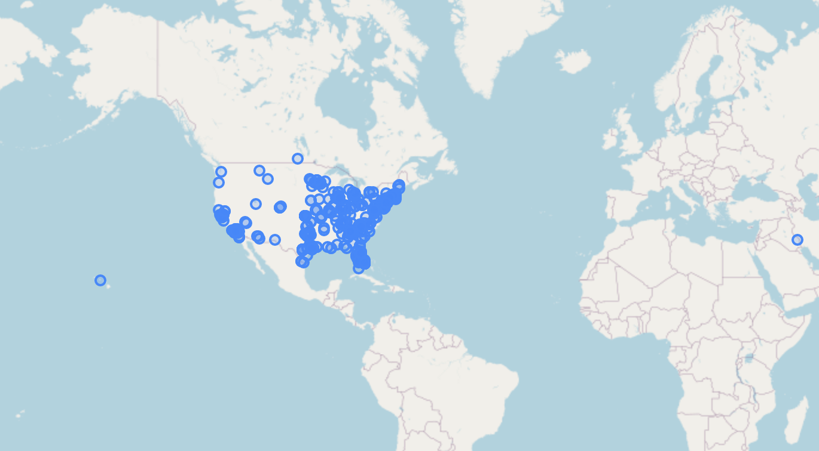
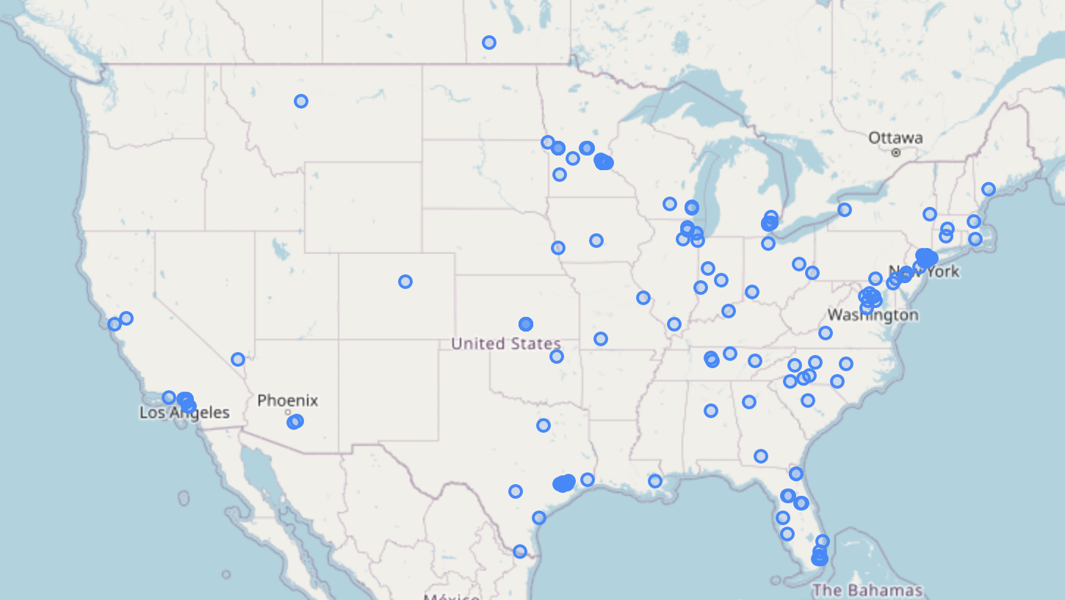
Lat & Long for Various Scenarios
Just MN Zip Codes (538)
Just Service Area Zip Codes (159)
Weekly Meeting (02/28/2023)
Hannah DeBruin

Slide 7
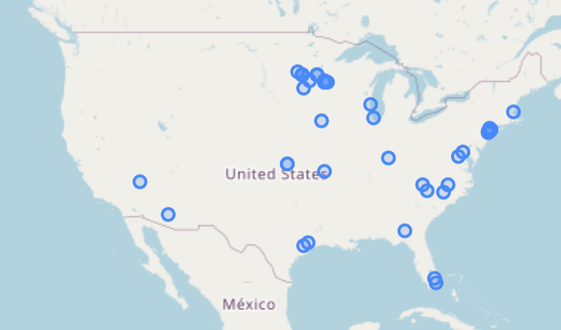
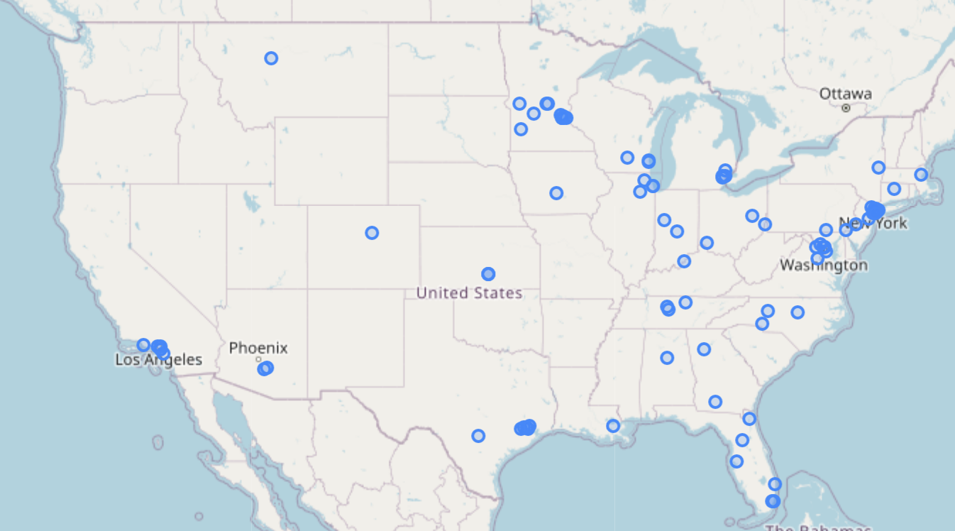
Lat & Long for Various Scenarios
Transit Agency and Zip Code Match (46)
Transit Agency and Fare Payment Match (94)
Weekly Meeting (02/28/2023)
Hannah DeBruin

Slide 8
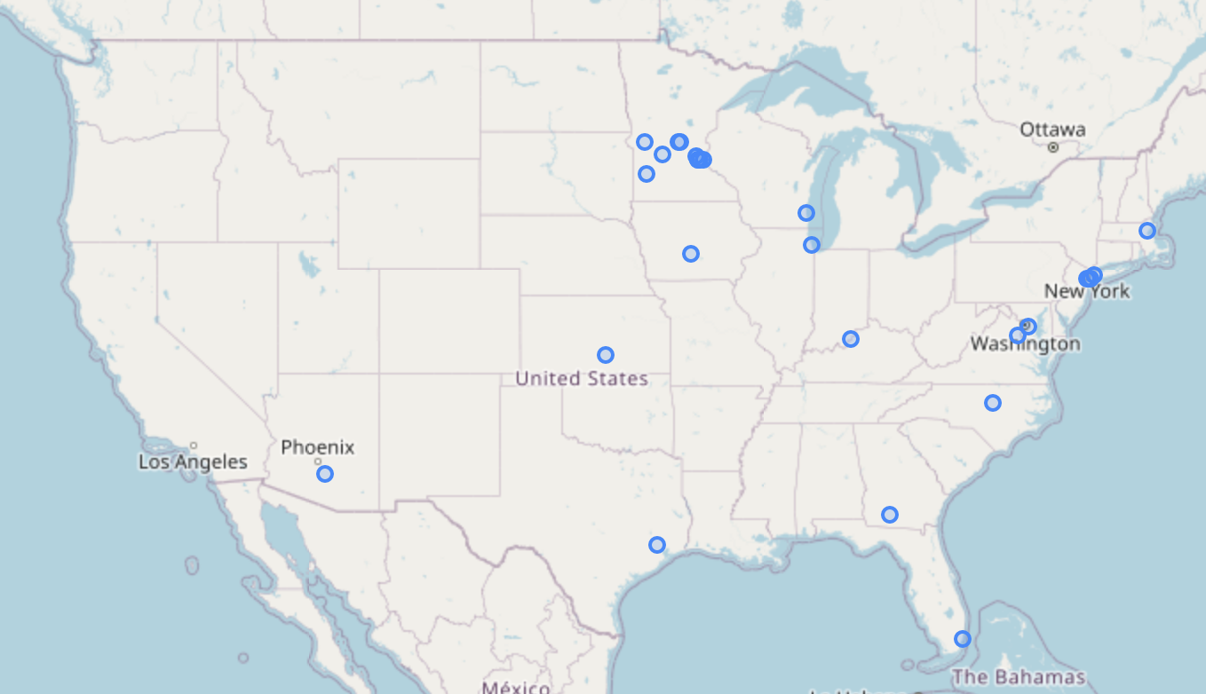
Lat & Long for Various Scenarios
All Filters (27)
Weekly Meeting (02/28/2023)
Hannah DeBruin

Slide 9
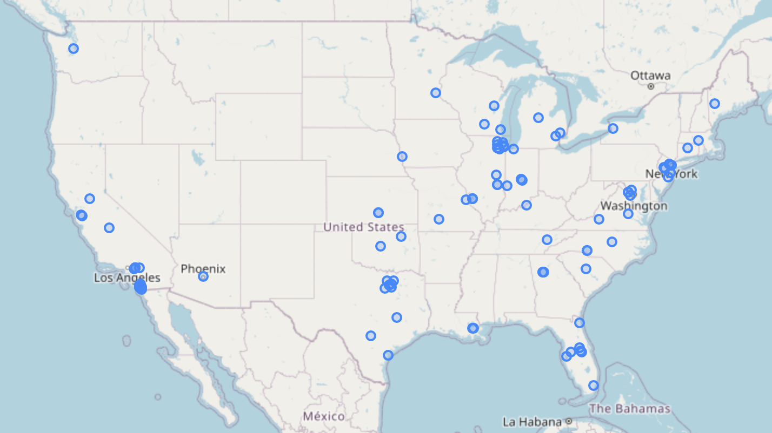
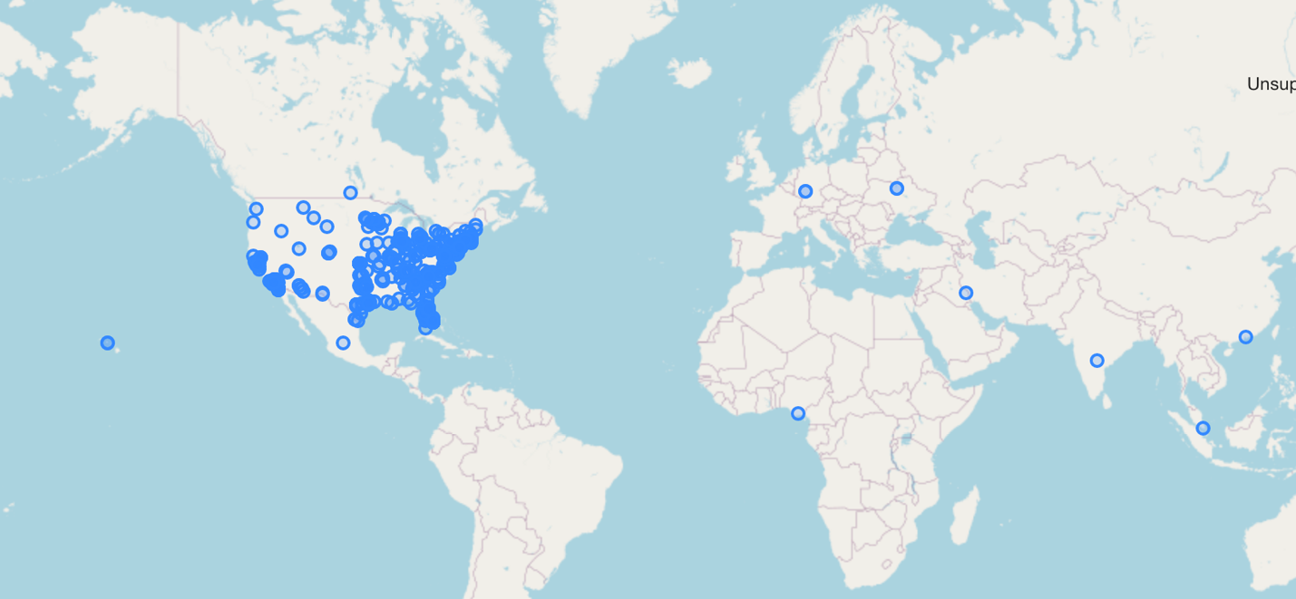
Lat & Long for Various Scenarios
Repeat Responses (All fields identical except for free-response and IP address) (179 total, 42 in MN zipcodes, 17 in Service Area)
Unique Responses (743)
Weekly Meeting (02/28/2023)
Hannah DeBruin

Slide 10
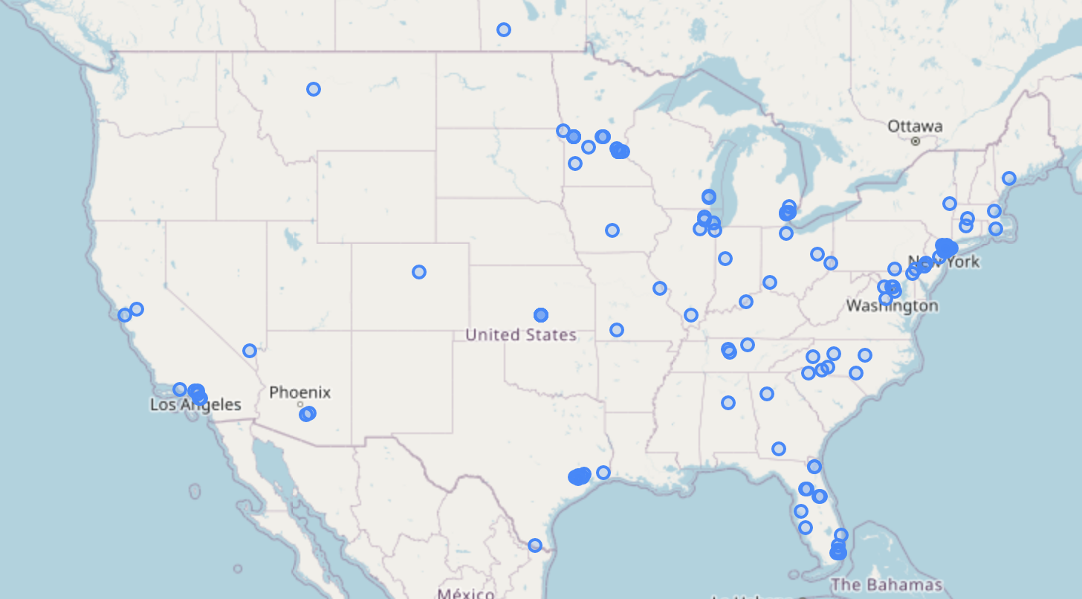
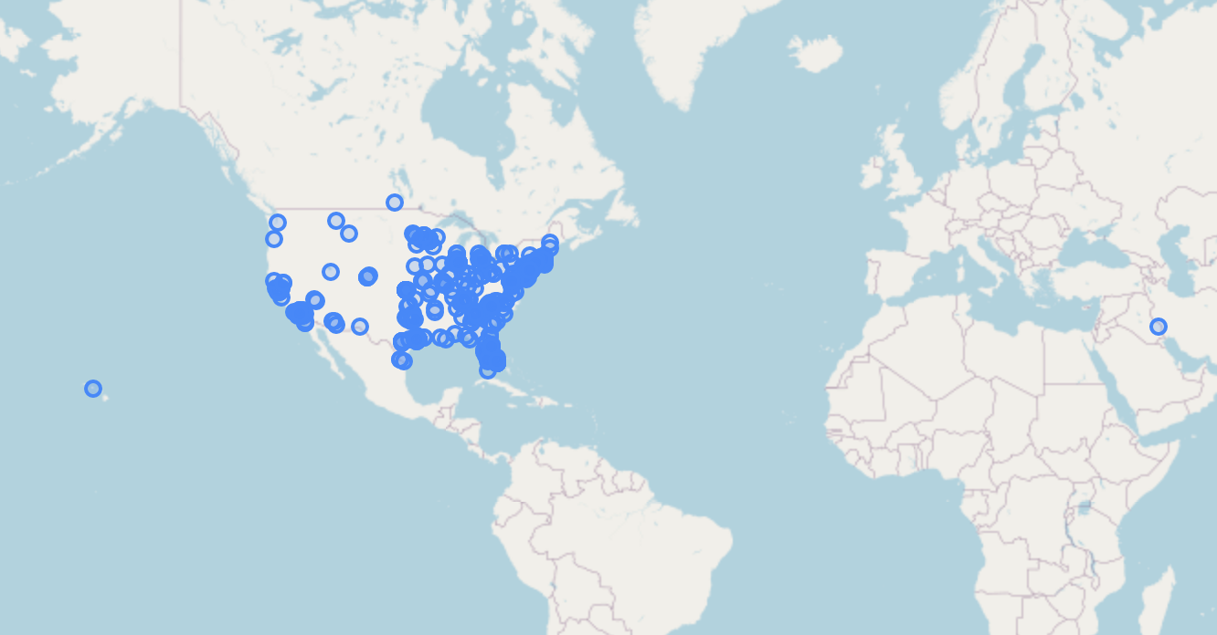
Lat & Long for Various Scenarios
Unique Responses with MN Zip Code (497)
Unique Responses with Service Area Zip Code (143)
Weekly Meeting (02/28/2023)
Hannah DeBruin

Slide 11
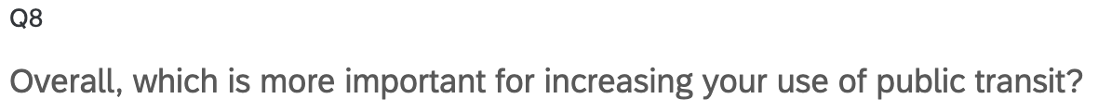
Filter Comparison – Q8
All Filters (27)
Unique Responses with MN Zip Code (497)
Weekly Meeting (02/28/2023)
Hannah DeBruin

Slide 12
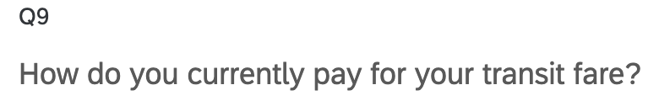
Filter Comparison – Q9
All Filters (27)
Unique Responses with MN Zip Code (497)
Weekly Meeting (02/28/2023)
Hannah DeBruin

Slide 13
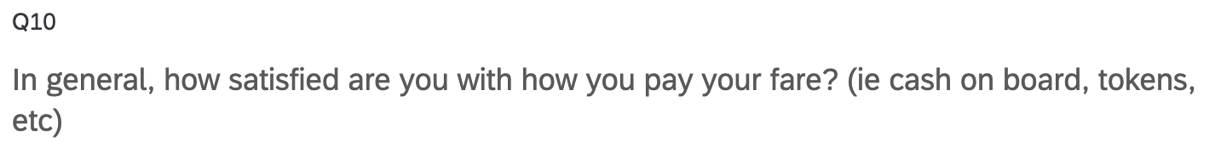
Filter Comparison – Q10
All Filters (27)
Unique Responses with MN Zip Code (497)
Weekly Meeting (02/28/2023)
Hannah DeBruin

Slide 14
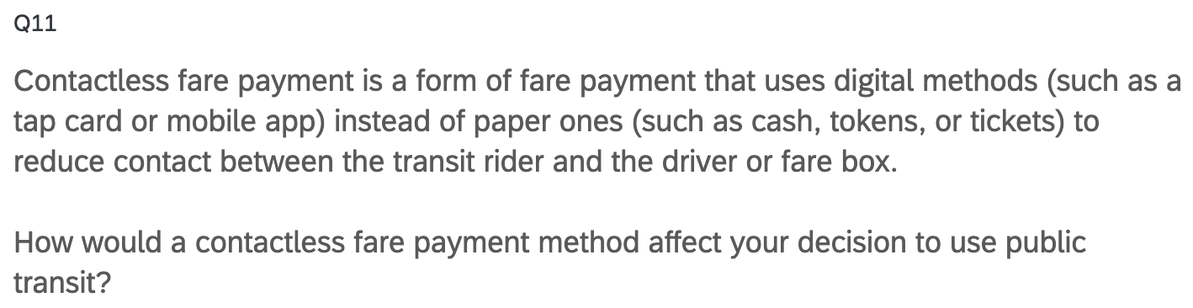
Filter Comparison – Q11
All Filters (27)
Unique Responses with MN Zip Code (497)
Weekly Meeting (02/28/2023)
Hannah DeBruin

Slide 15
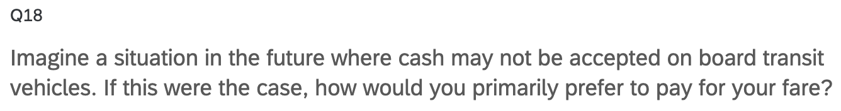
Filter Comparison – Q18
All Filters (27)
Unique Responses with MN Zip Code (497)
Weekly Meeting (02/28/2023)
Hannah DeBruin

Slide 16

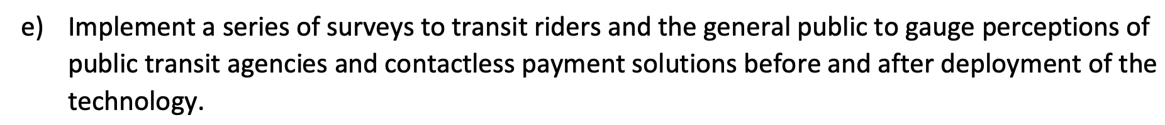
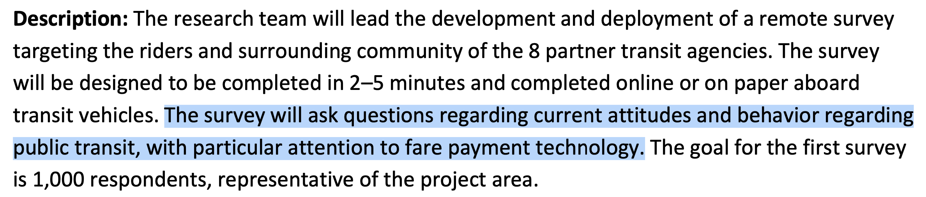
Survey Objectives from Work Plan
Weekly Meeting (02/21/2023)
Hannah DeBruin

Slide 17
Survey Objectives Summarized
Transit usage/behavior, and return post-COVID
Attitudes about transit quality of service
Attitudes about transit COVID safety
Attitudes about fare payment
Attitudes about trip planning
*Will look through data from all MN zip codes, with only survey durations between 5 and 30 minutes
(475 rows total)
Weekly Meeting (02/21/2023)
Hannah DeBruin

Slide 18
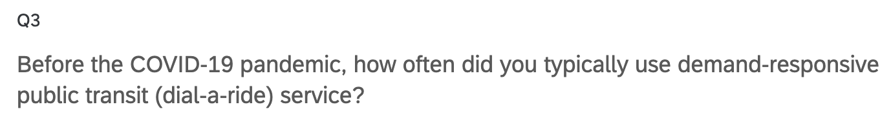
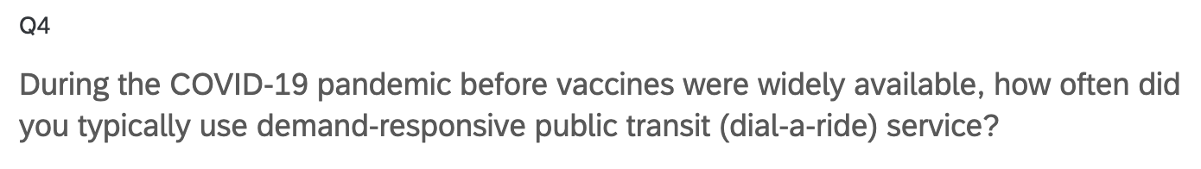
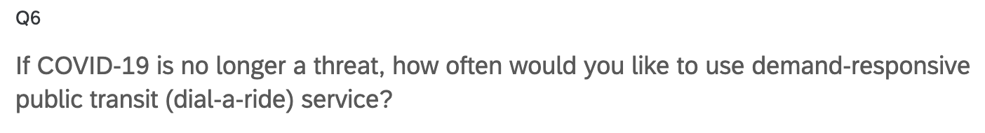
Current Transit Usage/Behavior
Weekly Meeting (02/21/2023)
Hannah DeBruin

Slide 19
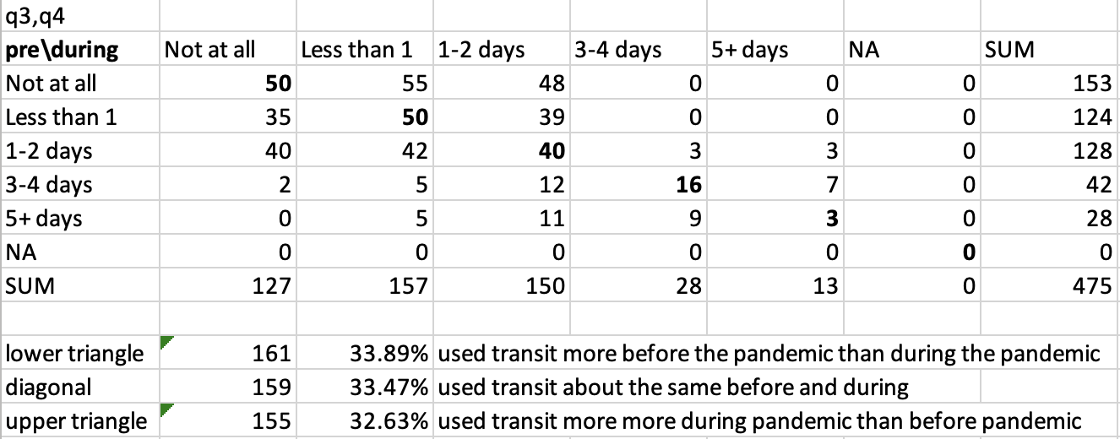
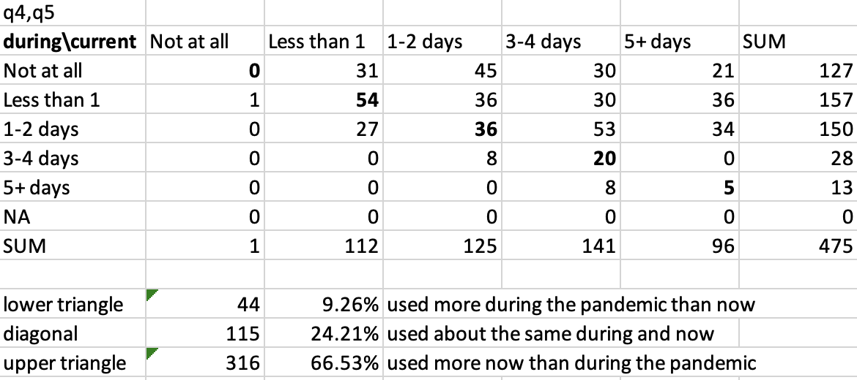
Current Transit Usage/Behavior
Weekly Meeting (02/21/2023)
Hannah DeBruin

Slide 20
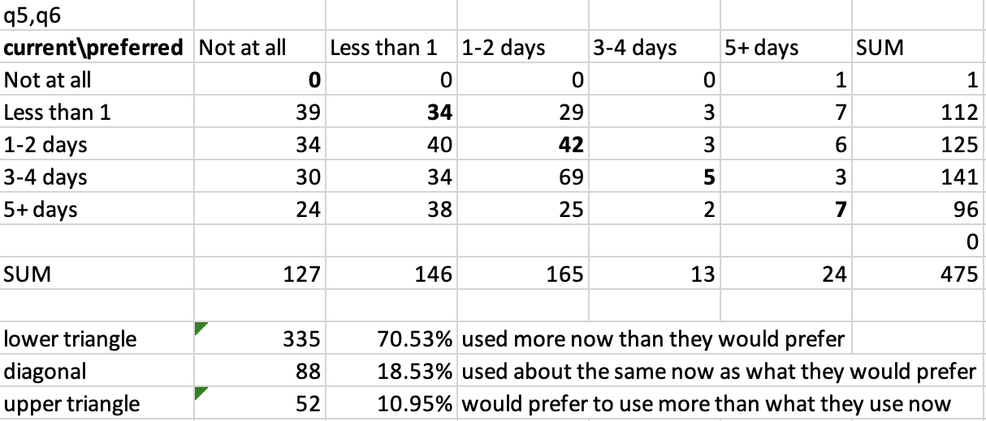
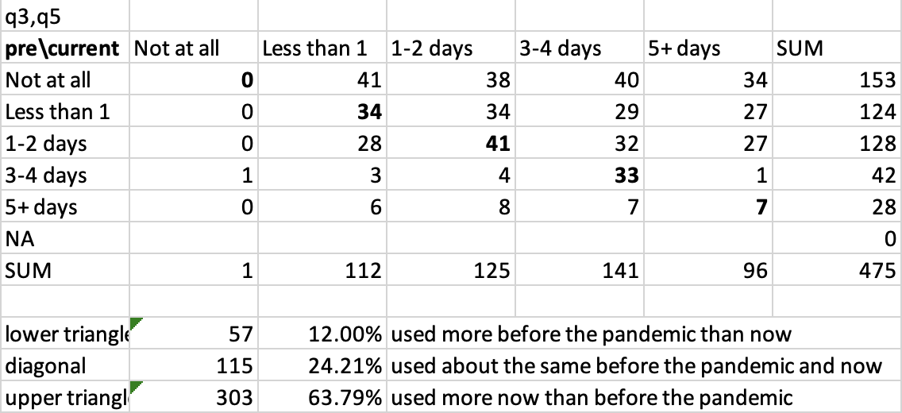

Current Transit Usage/Behavior
want to use transit less?
strong return? – want to verify with NTD data
Weekly Meeting (02/21/2023)
Hannah DeBruin

Slide 21
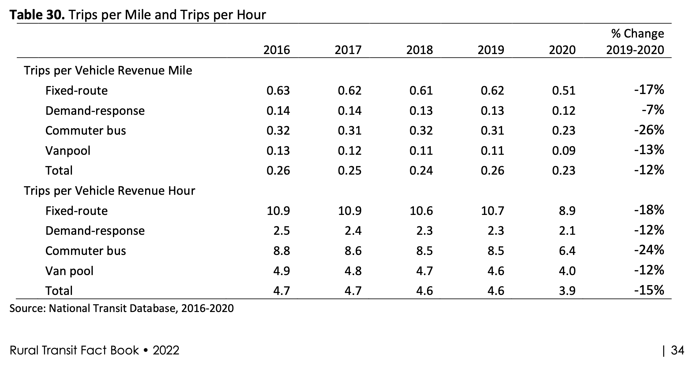
Current Transit Usage/Behavior
Weekly Meeting (02/28/2023)
Hannah DeBruin

Slide 22
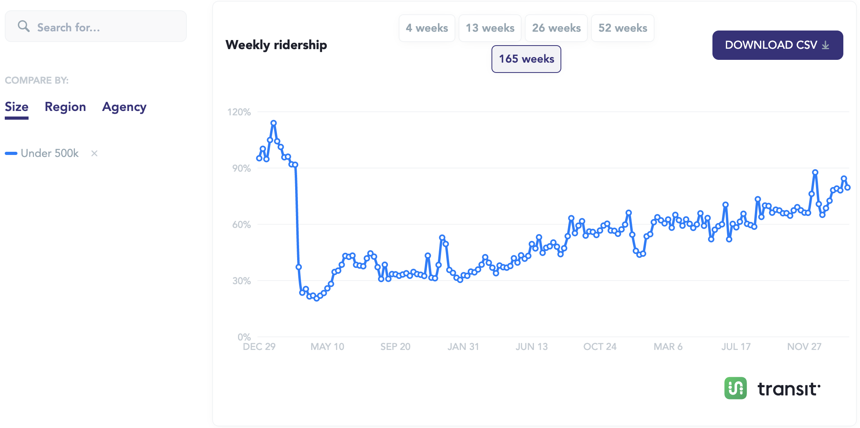
Current Transit Usage/Behavior
https://transitapp.com/APTA
look at NTD data we received from Elliot?
Weekly Meeting (02/28/2023)
Hannah DeBruin

Slide 23
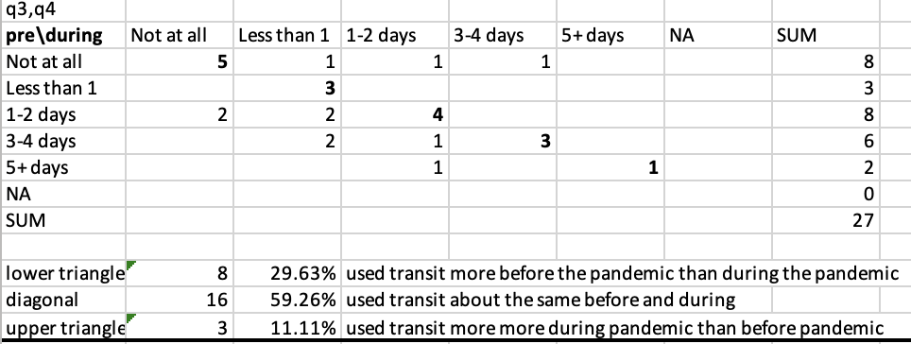
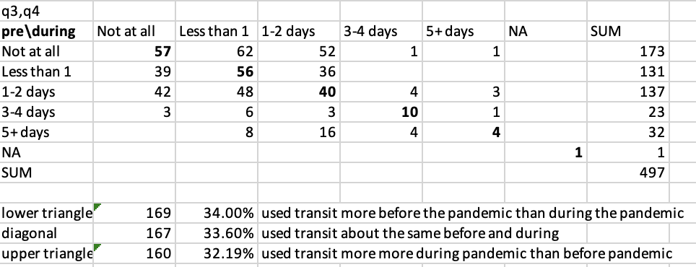
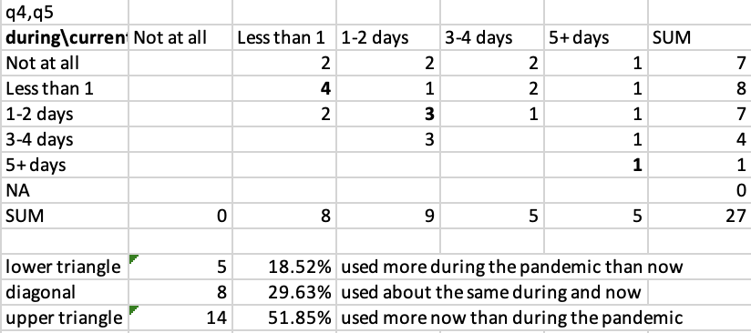
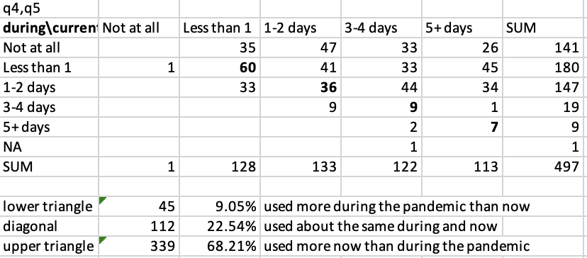
Current Transit Usage/Behavior
All Filters (27)
Unique Responses with MN Zip Code (497)
Weekly Meeting (02/28/2023)
about the same
Hannah DeBruin

Slide 24
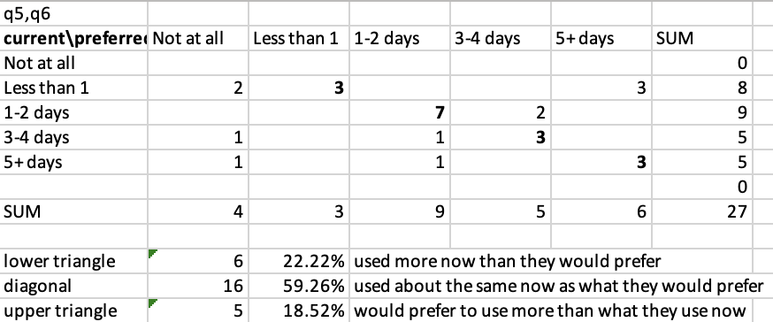
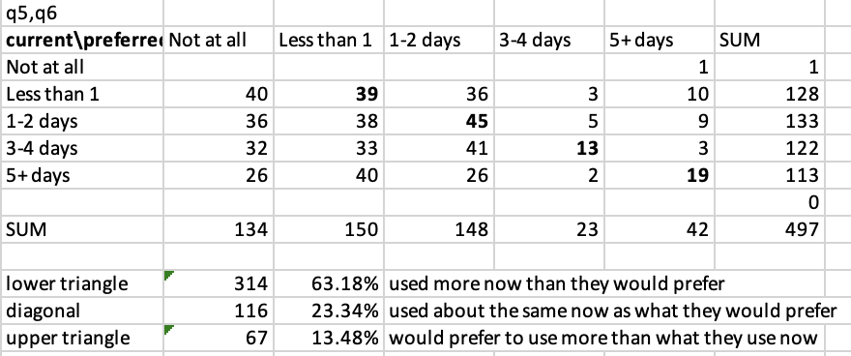
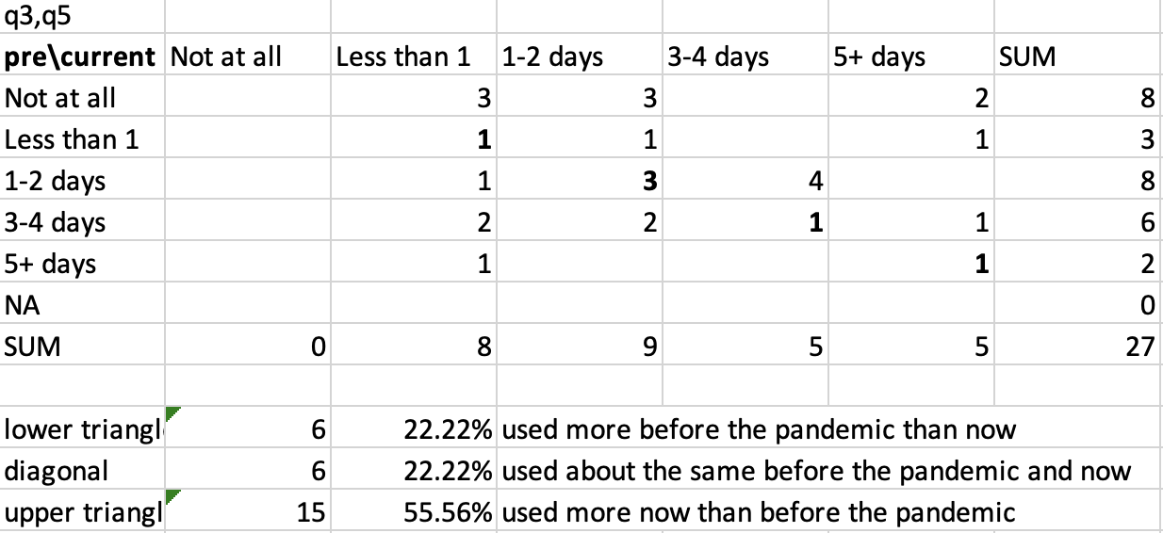
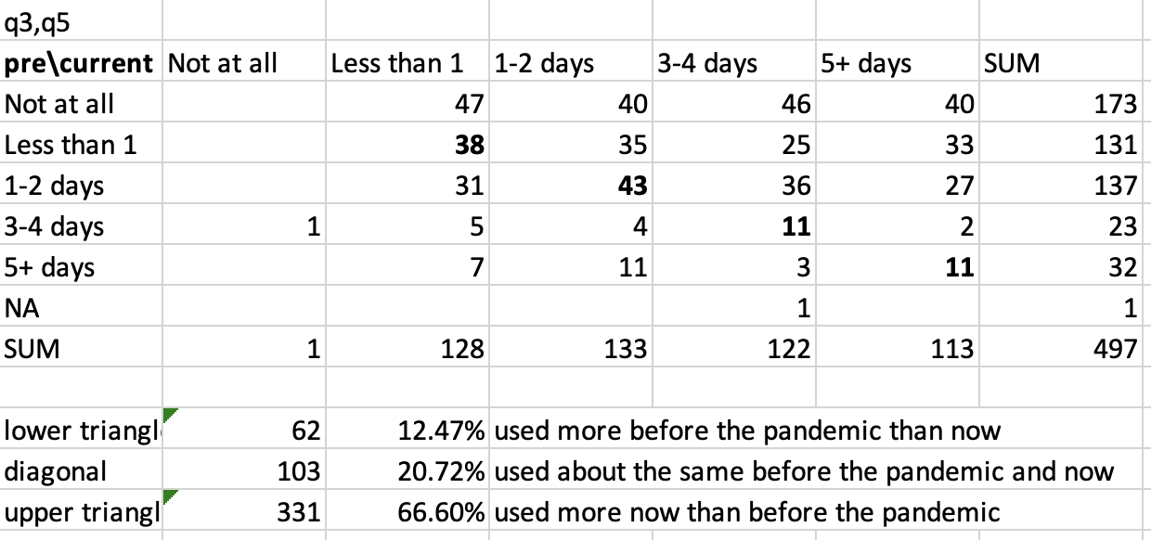


Current Transit Usage/Behavior
All Filters (27)
Unique Responses with MN Zip Code (497)
Weekly Meeting (02/28/2023)
about the same
Hannah DeBruin

Slide 25
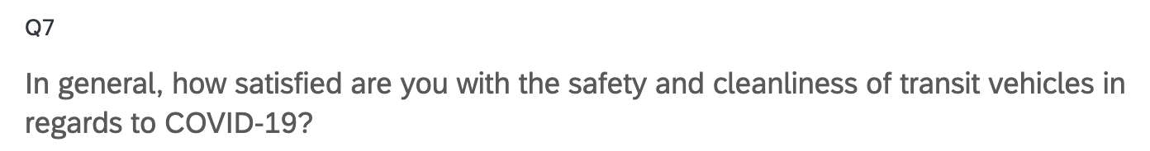
Attitudes about COVID Safety, Quality of Service
Weekly Meeting (02/21/2023)
Hannah DeBruin

Slide 26
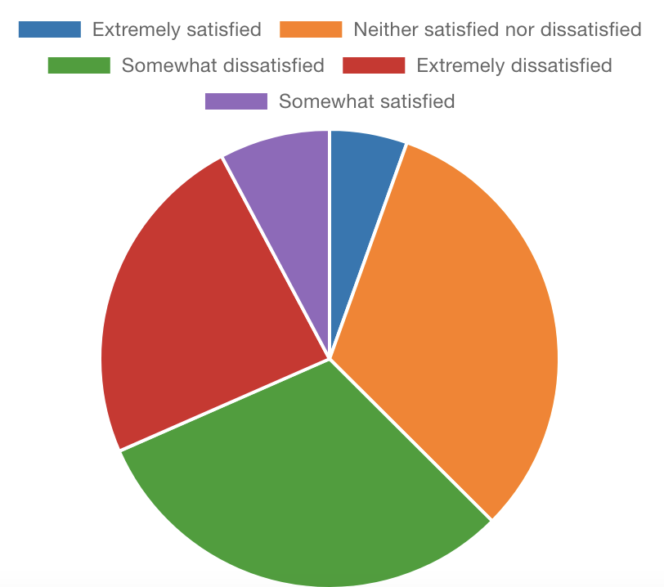
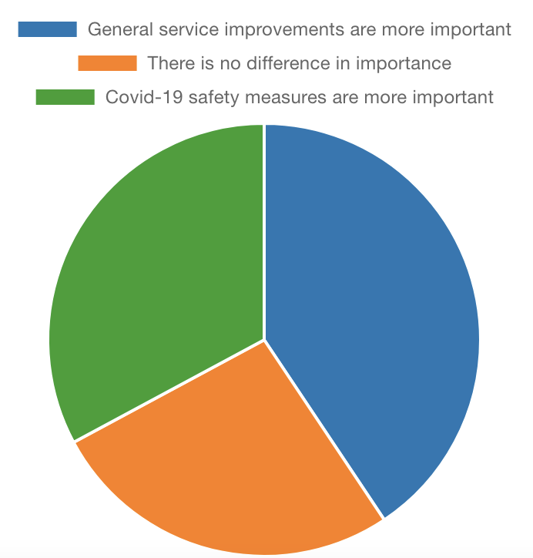
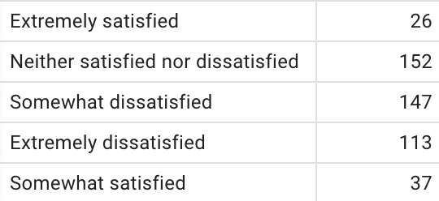
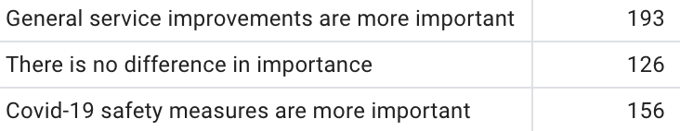
Attitudes about COVID Safety, Quality of Service
Safety and Cleanliness Satisfaction
Service v Cleanliness
Weekly Meeting (02/21/2023)
Hannah DeBruin

Slide 27
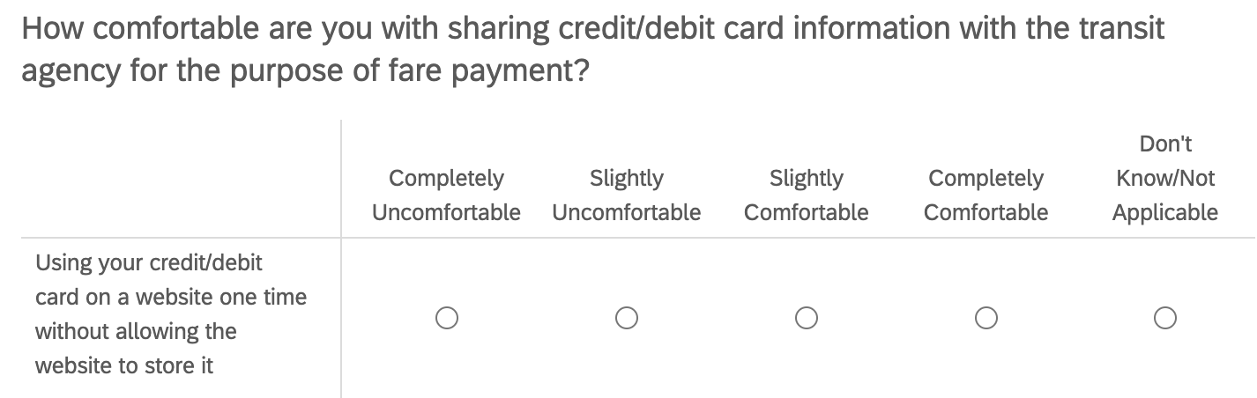
Attitudes about Fare Payment
Q17_1:4
Weekly Meeting (02/21/2023)
Hannah DeBruin

Slide 28
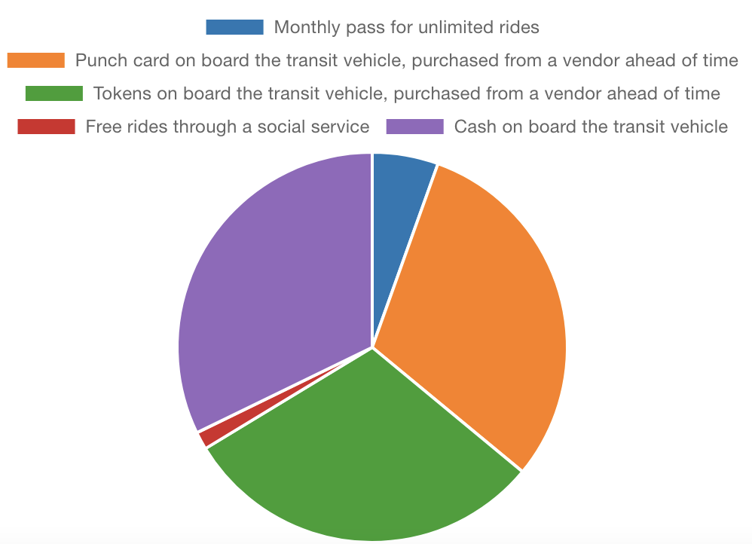
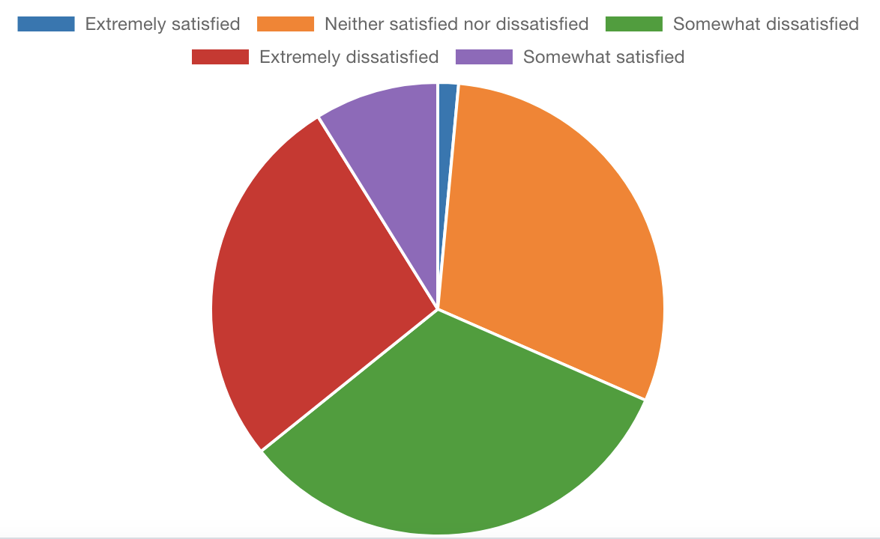
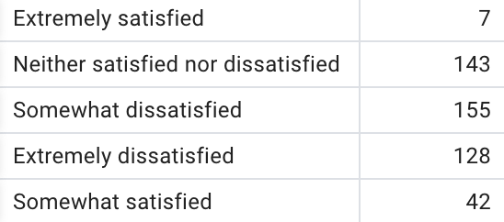
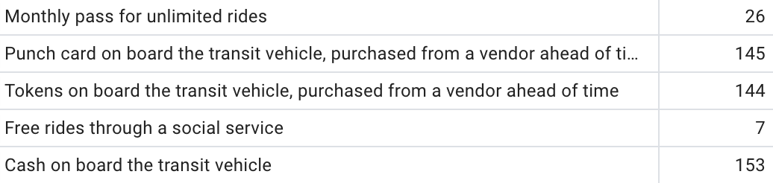
Attitudes about Fare Payment
Current Fare Payment
Satisfaction with Current Fare Payment
Weekly Meeting (02/21/2023)
Hannah DeBruin

Slide 29
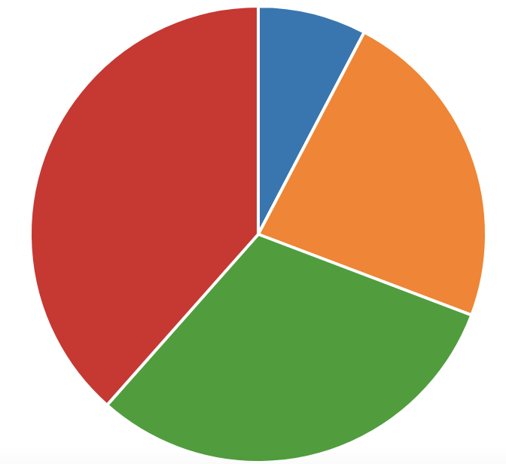
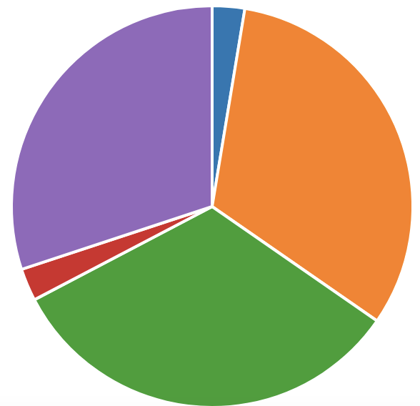
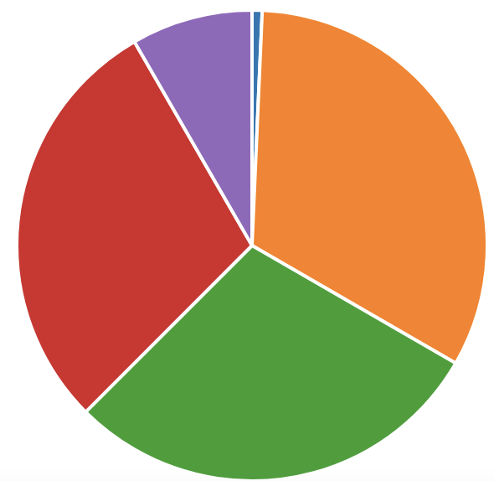
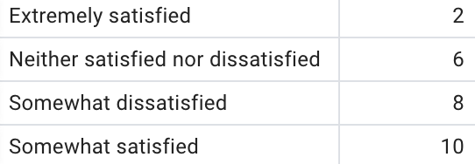






Attitudes about Fare Payment
Monthly Pass
Tokens
Cash on Board
extremely satisfied
extremely satisfied
extremely satisfied
somewhat satisfied
extremely dissatisfied
somewhat satisfied
neutral
neutral
neutral
extremely dissatisfied
somewhat satisfied
somewhat dissatisfied
somewhat dissatisfied
somewhat dissatisfied
Punch Card
Free Rides through
Social Service
extremely dissatisfied
neutral
somewhat satisfied
somewhat dissatisfied
somewhat dissatisfied
somewhat dissatisfied
Weekly Meeting (02/21/2023)
Hannah DeBruin

Slide 30


Attitudes about Fare Payment
Weekly Meeting (02/21/2023)
Hannah DeBruin

Slide 31



Fare Payment Capabilities
Technology
Payment Method
Weekly Meeting (02/21/2023)
Hannah DeBruin

Slide 32




Fare Payment Capabilities
Q13 - Smartphone?
Q14 - Data Concern
Weekly Meeting (02/21/2023)
Hannah DeBruin

Slide 33



Fare Payment Capabilities
Q16 – Payment Method
Q18 – No Cash Payment Preference
Weekly Meeting (02/21/2023)
Hannah DeBruin

Slide 34



Attitudes about Trip Planning
Weekly Meeting (02/21/2023)
Hannah DeBruin

Slide 35





Sociodemographics
Qualtrics also collects:
-duration to complete
-QR code v link
-lat & long
-datetime started, completed
Weekly Meeting (02/21/2023)
Hannah DeBruin

Slide 36



Sociodemographics
Age
Race/Ethnicity
Weekly Meeting (02/21/2023)
Hannah DeBruin

Slide 37





Fare Payment Attitude Split by Demographic
Age 18-24
Age 35-44
Weekly Meeting (02/21/2023)
Hannah DeBruin

